Slide 1
QATRA
Logo Presentation

Slide 2
Project Description

Slide 3
What is QATRA?
A National Smart Water Management System uses IoT sensors, smart meters, gateways, data platforms, and mobile application to:
Monitor water consumption in real-time.
Detect leaks, bursts, and unusual usage.
Enable prepaid and automated billing.
Optimize irrigation scheduling in agriculture.
Support predictive maintenance of water networks.

Slide 4
What will QATRA Introduce
QATRA will introduce a next-generation smart water management platform that enhances efficiency, transparency, and user control. Its key features include:
Real-time Consumption Monitoring – Track water usage instantly via mobile app and web dashboard.
Prepaid Smart Meter Integration – Seamless balance recharge and automated usage control.
Leak Detection & Alerts – Immediate notifications for abnormal consumption or catastrophic leaks.
Remote Valve Control – Ability to cut off or restore water remotely when needed.
Data Analytics & Insights – Provides detailed reports on consumption patterns to help optimize usage.
Customer Support Integration – Faster issue reporting, status tracking, and service requests.
Sustainability Tools – Helps reduce water waste and supports Egypt’s water-saving goals.

Slide 5
Inspiration Process

Slide 6
Words That Describe QATRA
Droplet – Flow – Conservation – Sustainability – Resource – Balance
Smart – Digital – Connected – Intelligent – Integrated – Monitoring – Control – Efficiency
Saving – Management – Awareness – Optimization - Transformation

Slide 7
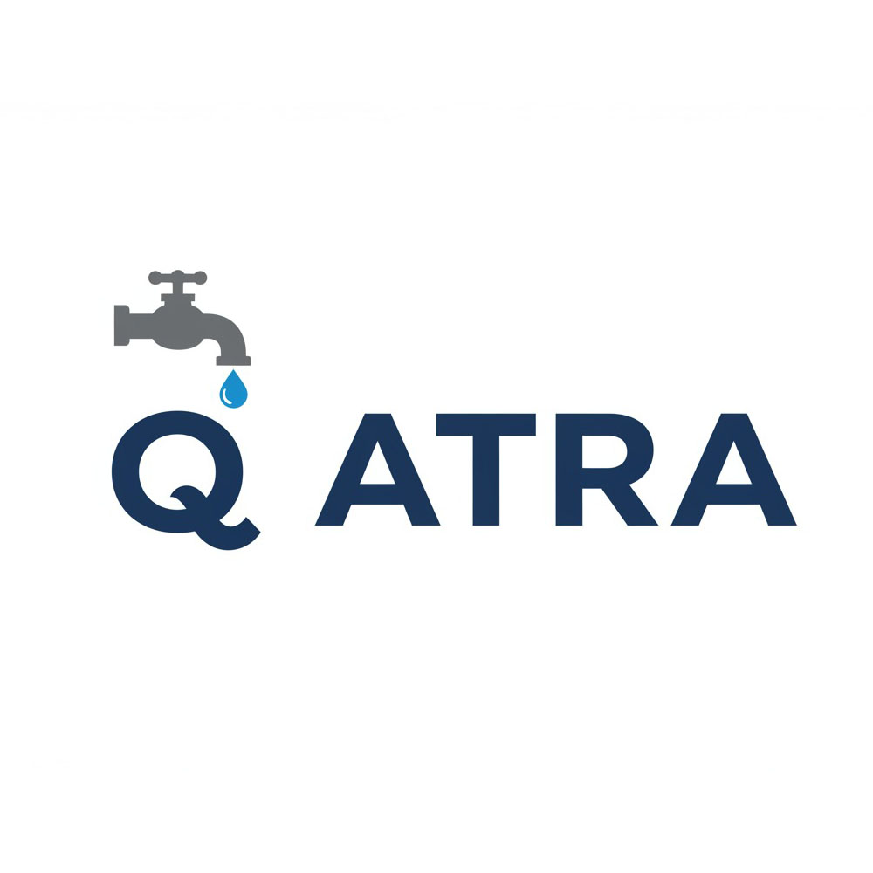
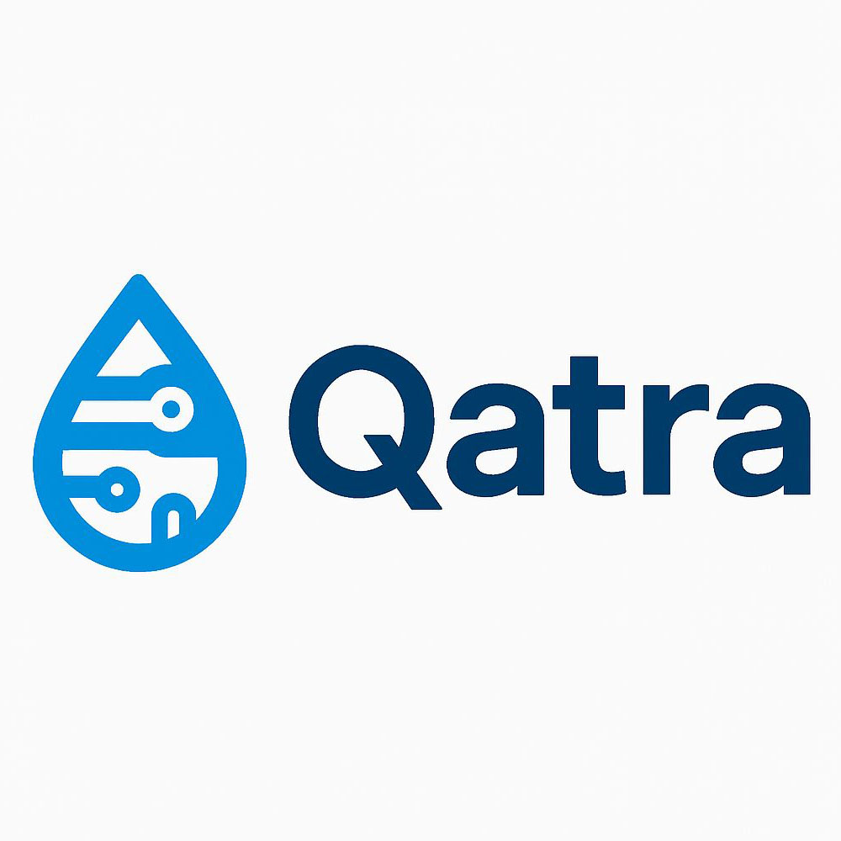
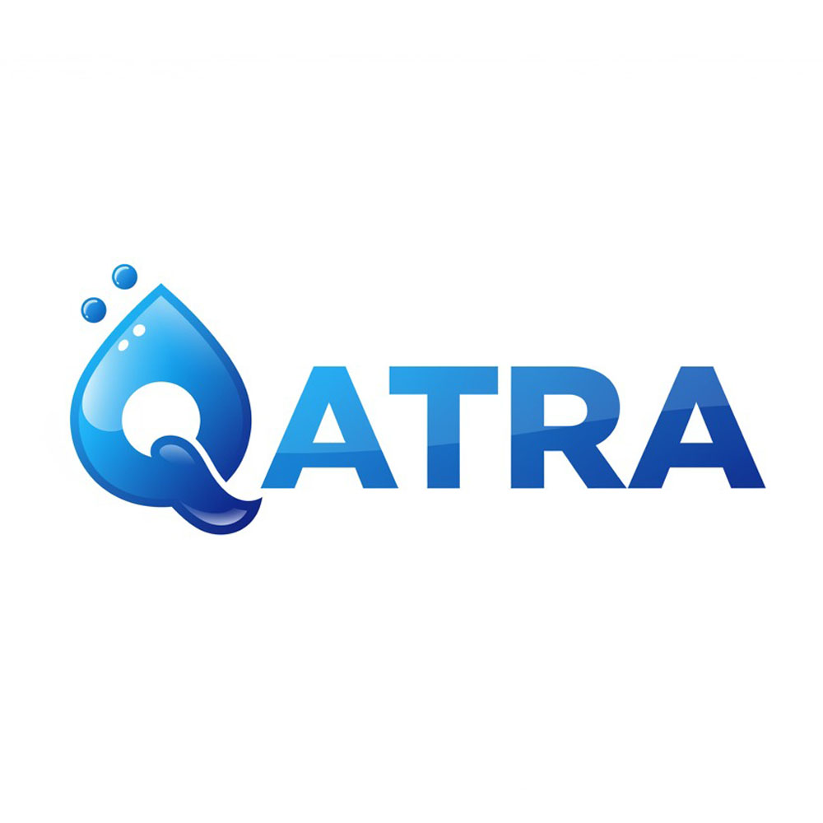
Inspiration Using AI Tools and Research

Slide 8
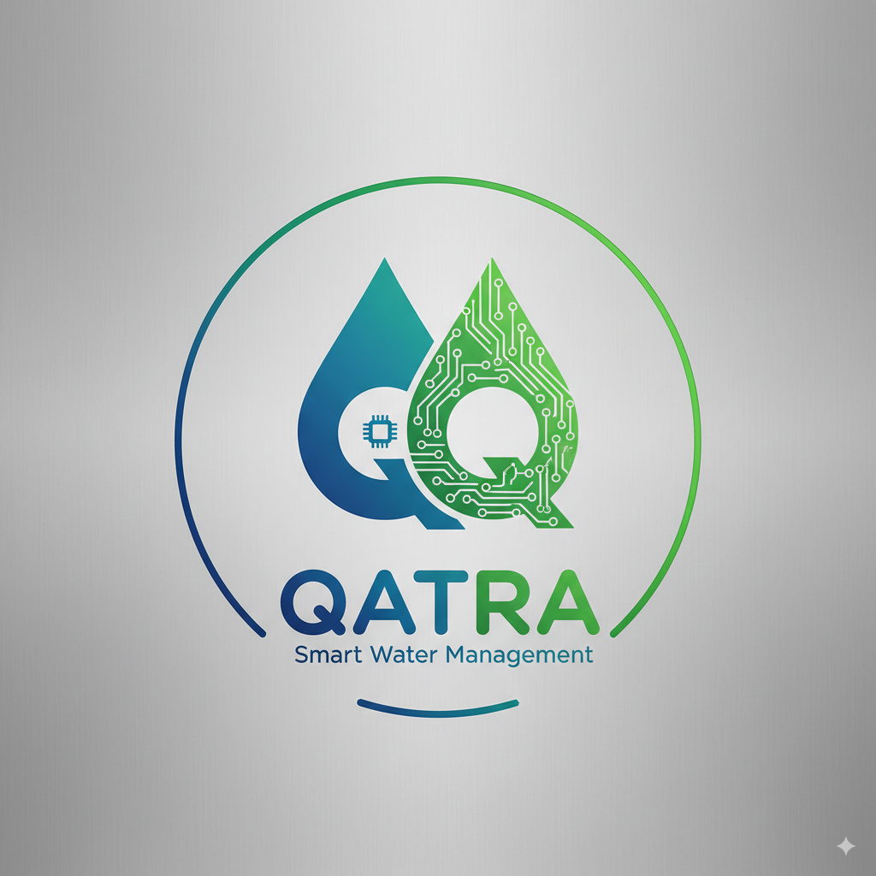
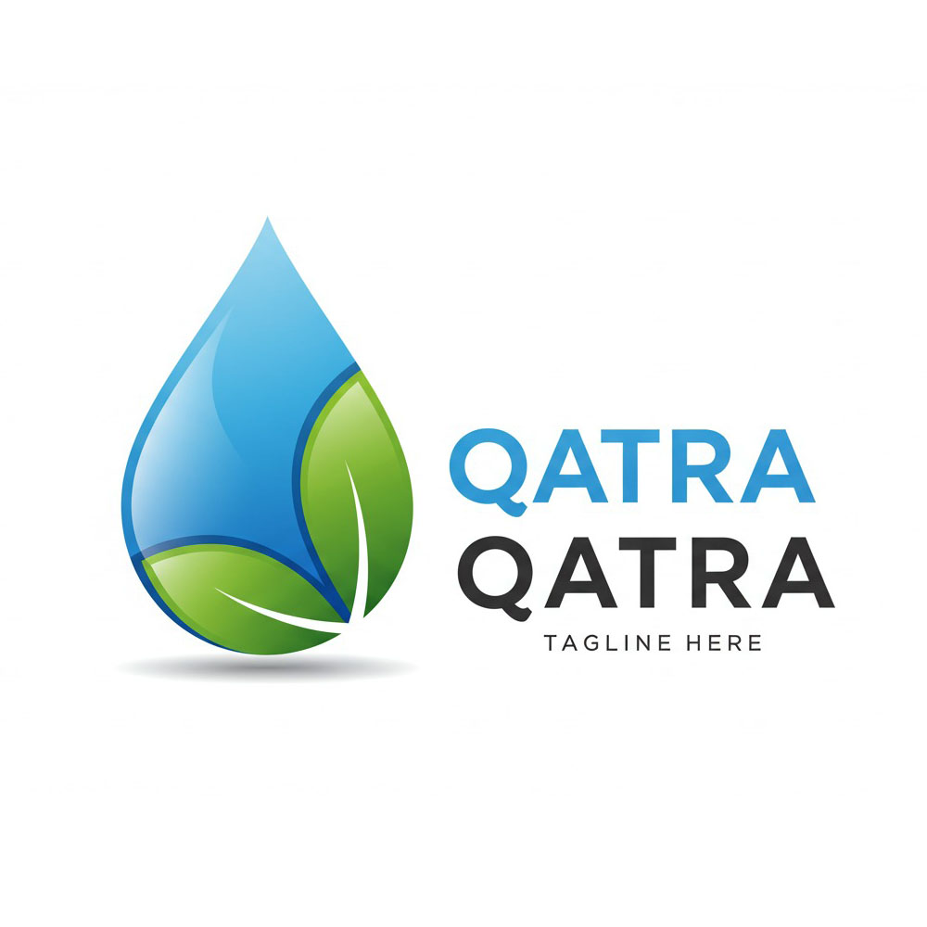
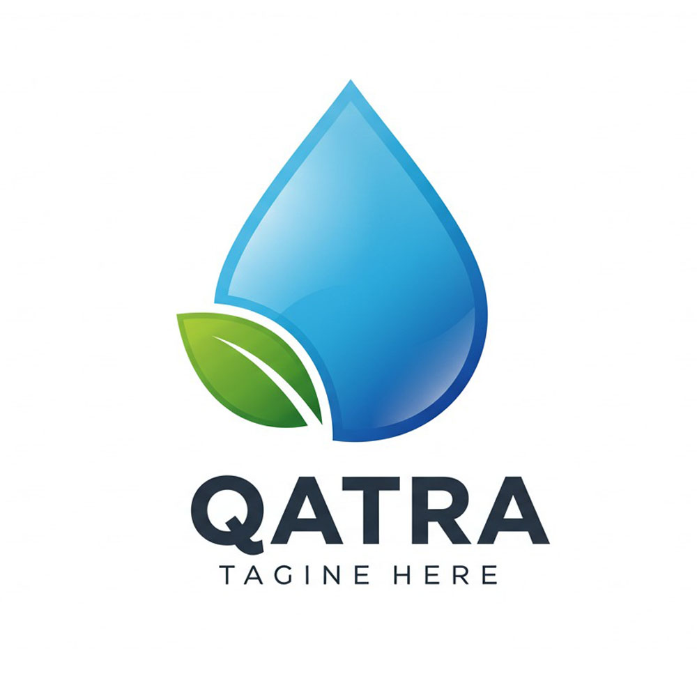
Inspiration Using AI Tools

Slide 9
Sketches for Logo

Slide 10


Wordmark Type

Slide 11

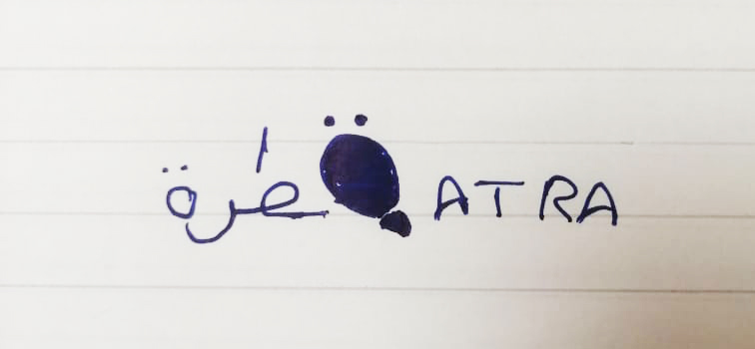
Wordmark Type

Slide 12

Monogram Type

Slide 13
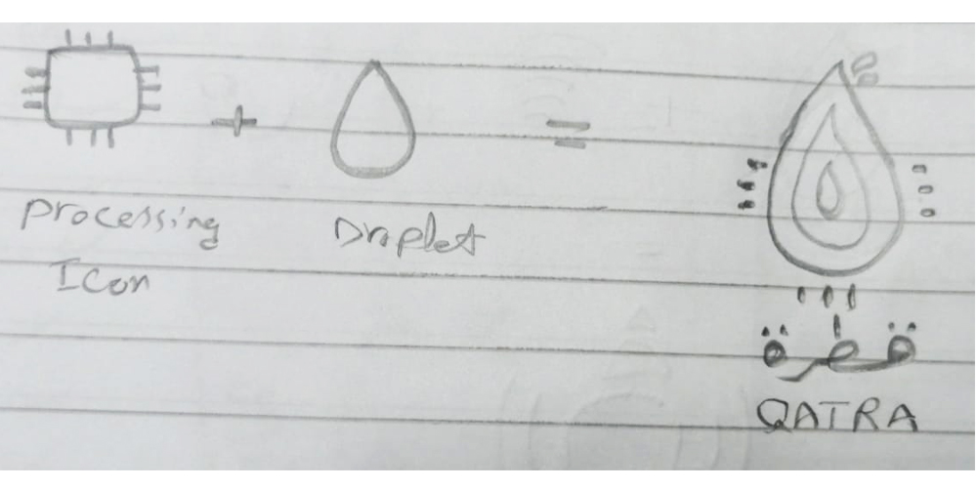
Combination Mark Type

Slide 14
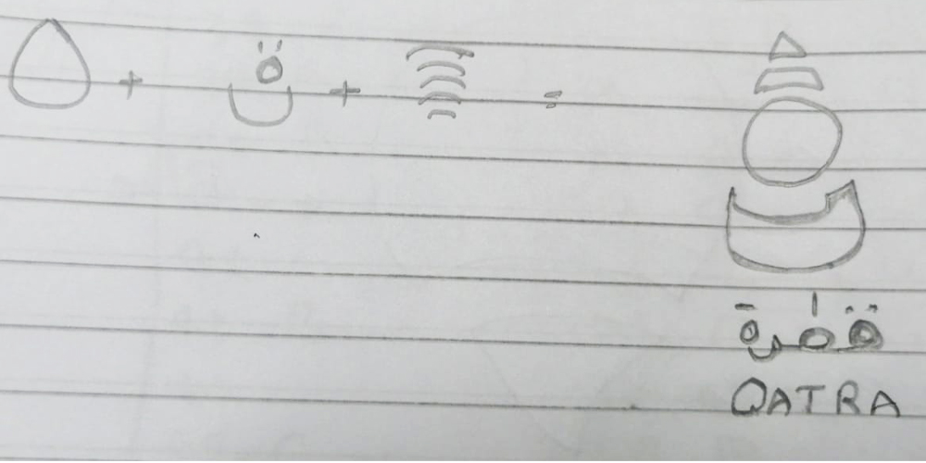
Combination Mark Type

Slide 15
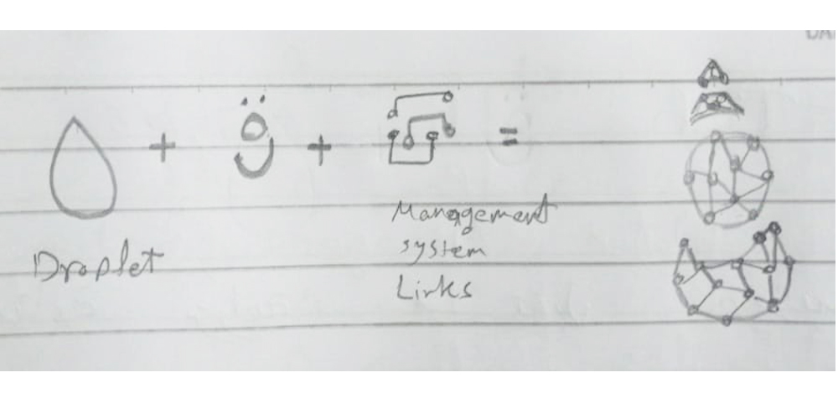

Combination Mark Type

Slide 16
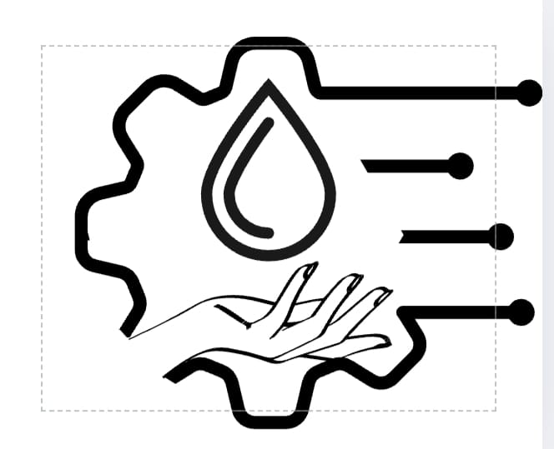

Combination Mark Type

Slide 17
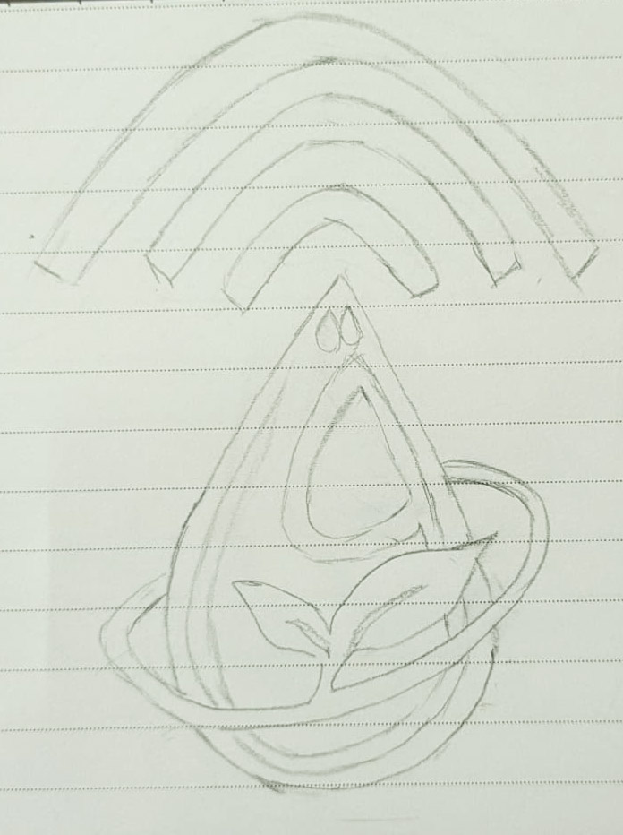
Combination Mark Type

Slide 18
Thank You

